Slide 1
Introduction to Simulation and Modeling
Azaz Ahmed Kiani

Slide 2
System Definition
(High-Level Flow Chart)
(Lecture 14)

Slide 3
High-Level Flow Chart
A high-level flow chart helps the practitioner obtain a fundamental understanding of the system logic.
It graphically depicts how the major components and events interact.
It also illustrates how the input and output data play a role in the model.
The chart is intended only to provide general information as to how the process flows.

Slide 4
Standard Flow Chart Symbols
There are four basic flow chart process symbols. These are the:
1. Oval
2. Rectangle
3. Tilted parallelogram
4. Diamond

Slide 5
Standard Flow Chart Symbols (guidelines)
The first guideline is that the symbols should be arranged so that the sequence of processes flows downward and to the right as much as possible.
The second guideline is that any given symbol should have only one connecting path into the symbol and only one connecting path out of the symbol.
The only exception to this rule is the decision icon, which has two different output paths.

Slide 6
Standard Flow Chart Symbols (oval symbol )
The oval symbol is used to designate both the start and stop processes.
The stop or end symbol is normally the last symbol present on the flow chart.
Even if the process has several different possible paths, there should still only be one stop or end symbol

Slide 7
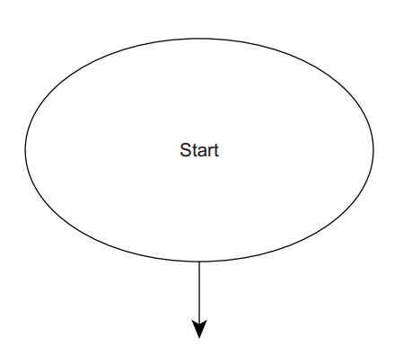
Standard Flow Chart Symbols (oval symbol )

Slide 8
Standard Flow Chart Symbols (Process Rectangle)
The rectangle is used to represent general-purpose processes that are not specifically covered by any of the other flow chart symbols.
The process rectangle is normally entered from the top or the left side.
It is exited from either the bottom or the right side.
In a high-level flow chart, a service time delay would be a common example of a process

Slide 9
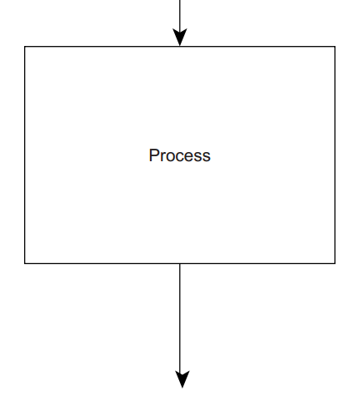
Standard Flow Chart Symbols (Process Rectangle)

Slide 10
Standard Flow Chart Symbols (Input / Output Tilted Parallelogram)
The tilted parallelogram is used for processes that involve some sort of input or output.
The tilted parallelogram is normally entered from the top or the left side
It is exited from either the bottom or right side.
An example of an input process symbol in a simulation program flow chart would be the creation or arrival of entities into a system.

Slide 11
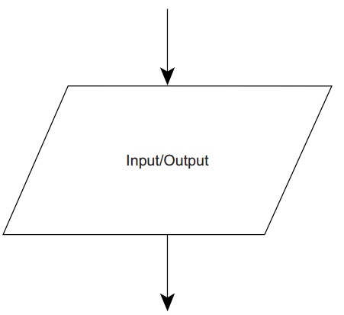
Standard Flow Chart Symbols (Input / Output Tilted Parallelogram)

Slide 12
Standard Flow Chart Symbols (diamond)
The diamond is used to represent a decision in the flow chart logic.
The diamond has one input connector but two output connectors.
The output connectors must specifically be labeled as either true or false or yes or no.
Because these responses are mutually exclusive, only one output path may be taken at a given time.

Slide 13
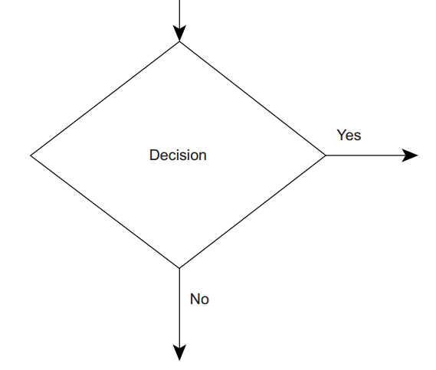
Standard Flow Chart Symbols (diamond)

Slide 14
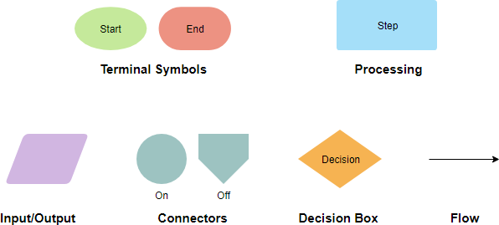
Standard Flow Chart Symbols)

Slide 15
Sample Flow Chart

Slide 16
Sample Flow Chart
The sample flow chart represents a simple system example
This is a single-queue, single-server system.

Slide 17
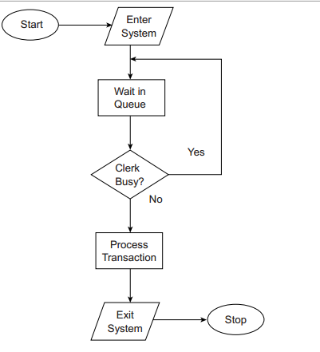
Sample Flow Chart

Slide 18
Components and Events to Model
In a small independently operating system, there is little question that the practitioner should attempt to model the entire system.
However, in a large interrelated system, it may be very difficult to identify which parts of the system to model.
On one hand, the model must contain enough content so that the behavior of the system is properly understood.
On the other hand, only a limited amount of time is available for most projects.

Slide 19
Components and Events to Model
Service models and manufacturing system models will naturally contain different system components.
Some more common system components that may be modeled include (Kelton et al., 2002):
Personnel
Machines
Transporters
Conveyors

Slide 20
Components and Events to Model (Personnel)
In service-related systems, personnel may include:
Sales clerks
Customer service representatives
In manufacturing systems, personnel would probably include:
Machine operators
Material handlers

Slide 21
Components and Events to Model (Machines)
Machines in service-related systems may include:
Computer or network systems
Automatic teller
Ticket machines
Scanners
X-ray machines
Machines in manufacturing-related systems could include:
Computer numerically controlled mills
Machining centers
Lathes
Turning centers
Robots

Slide 22
Components and Events to Model (Machines)
A transporter is any kind of vehicle that is used to move entities from one location to another.
In transportation service models, transporters may include vehicles such as
Airplanes
Buses
Trains
In manufacturing-related systems, there may be
Forklifts
Hand trucks

Slide 23
Components and Events to Model (Machines)
Note that there is also a distinction between free-path and fixed-path transporters.
Free-path transporters can go between different locations without respect to following a specific path or the presence of other vehicles.
A typical example of a free path transporter is a fork lift. Fork lifts typically can move between points without a specific track.
Forklifts can also go around other transporters because they are not restricted to movement on rails.
On the other hand, fixed-path or guided transporters must follow a specific rail or track and can be affected by the presence of other vehicles.
A typical example of a fixedpath transporter would be a rail train.

Slide 24
Components and Events to Model (Conveyors)
Conveyors are devices that can move entities between locations without the conveyor device itself physically moving.
The conveyor actually physically stays in the same place, but the belt or rack does the moving.
Examples of conveyors in service systems include:
Moving sidewalks
Escalators
Chair lifts

Slide 25
Processes and Events
The practitioner must also decide what system events should be included in the model.
Service System Processes and Events
Arrival of customers at a processing area
Customer queue behavior
Service processing
Payment for the goods

Slide 26
Processes and Events (Banking Service Processes)
In a service-type system such as a bank, there are actually many different types of transactions that the
customer may require.
Deposits
Withdrawals
Money orders
Cashier’s checks

Slide 27
Events Not to Model
The practitioner may deliberately elect not to model some events.
These would typically include events with very limited impact on the system outputs.
Limited impact may be the result of the small importance or infrequent occurrence of the event.

Slide 28
Data to Be Included in the Model
There are input data and output data.
Input data are what drive the system,
Output data are what result from the system.

Slide 29
Input data
A fundamental concept in this process is to break down the types of data into as many different independent types as possible.

Slide 30
Types of Input Data
There are two general categories of input data.
The first category is related to the concept of system entities.
Common examples of entities include customers, passengers, and job orders.
Typical types of input data associated with entities are the time between arrivals to the system, the number of entities in an arrival, and entity processing times for various operations.
The second category involves system resources.
System resources are the parts of the system that process the system entities.
Common examples of system resources are personnel, manufacturing equipment, and vehicles.
System resource input data include break times, breakdown or failure rates, operating capacities, and movement speeds.

Slide 31
Output Data
Output data are generally used to measure performance levels.
These measures of performance are used to validate the model and conduct model experimentation.
Average System Time
Average Queue Time
Average Utilization Rates for Multiple Resources

Slide 32
Sample Flow Charts

Slide 33
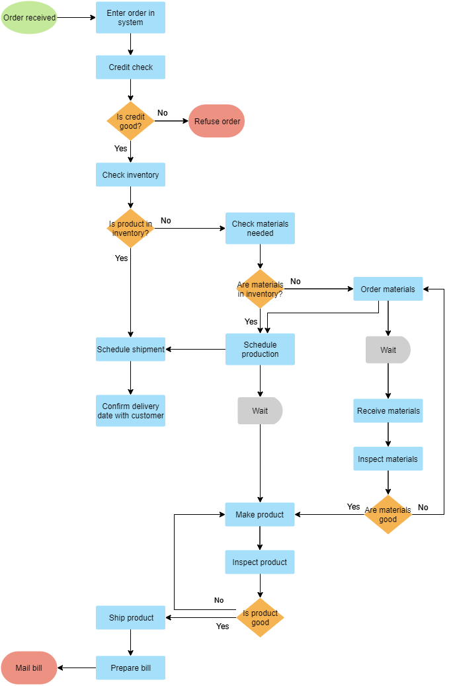

Slide 34
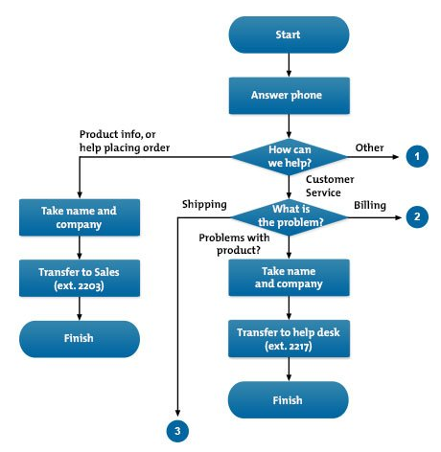

Slide 35
Summary
Any Questions?

